Slide 1
Autonomous Vehicle for Coral Reef Monitoring
4
Coral
Self-Defined
Team 4
Sean Nemtzow, Constantinos Gerontis, Anirudh Watturkar, Mrinal Ghosh, Prudence Aquiatan
Notes:
prudence title, people name

Slide 2
4
Coral
Self-Defined
Problem Statement
Coral reefs dying at an alarming rate
Global warming, ocean acidification, pollution
Health of coral reefs is extremely important
Marine life, coasts, tourism
Manual coral reef monitoring is arduous & expensive
Hinders efforts to preserve reef environments
Current surveying techniques inefficient & disruptive
Notes:
anirudh

Slide 3
4
Coral
Self-Defined
Proposed Solution
Surface-level solar-powered aquatic autonomous vehicle
Consistent monitoring and imaging schedule of a specified area
Multiple sensors and camera
Gather data and color-corrected images to track coral bleaching
Onboard data accessed physically or remotely
Long-term use, non-disruptive
Notes:
sean

Slide 4
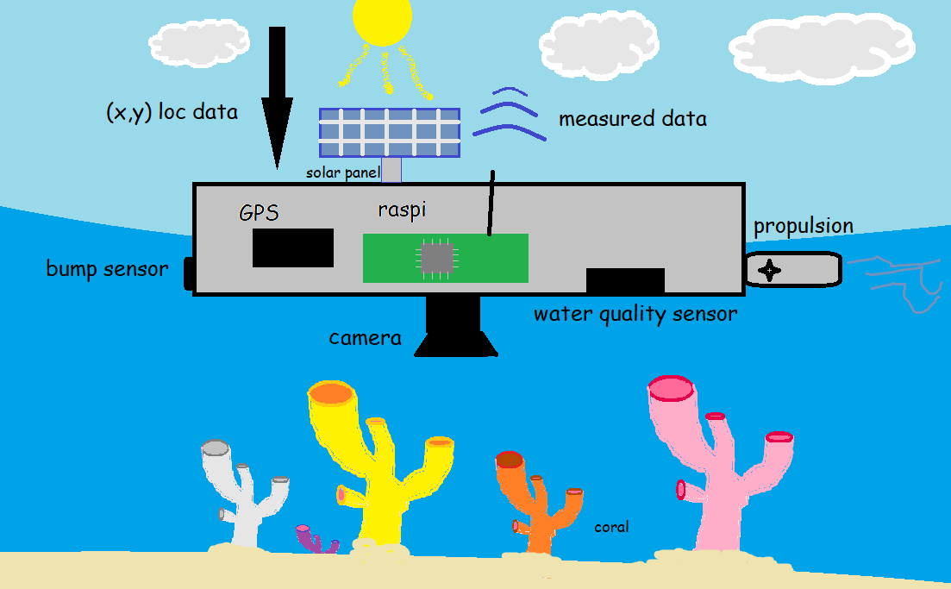
4
Coral
Self-Defined
Visualization
Notes:
mrinal

Slide 5
4
Coral
Self-Defined
Deliverables
Aquatic autonomous vehicle capable of:
Patrolling specific area on a consistent basis
Collecting measurements & color corrected images of reef
Temporarily storing data for easy remote or physical access
Data pipeline capable of:
Handling stream of metrics and images on a daily basis
Taking time and location stamped images
Extracting useful metrics from data
Overall coral health and water quality
Notes:
stinos

Slide 6
4
Coral
Self-Defined
Requirements
Functions
Measure water quality & take color corrected images of reef
Measurement frequency of reading / minute
Image Density of 10,000 images/ Km²
Locational Accuracy less than 5m
Store data onboard for physical or remote access
Store upwards of 64Gb of data on-board
At least 75% coverage of a specified area up to 0.25 Km²
Notes:
sean
6

Slide 7
4
Coral
Self-Defined
Requirements (cont.)
Objectives
Long-term: spend weeks to months at sea
Daily monitoring schedule following a path in specific area
Constraints
Cost < $1000
Accuracy of location data
GPS accurate to 3m worst case
Power
8 hrs of sunlight a day
Hardware Limitations of Raspberry PI v4 (w/ 2GB RAM)
Notes:
anirudh

Slide 8
4
Coral
Self-Defined
Competing Technologies
Robojelly (VT, UT-Dallas, FAU)
Jellyfish based robotic drones
SoFi (MIT)
Soft robotic fish
Blue Robotics BlueROV2 (AIMS)
Tethered underwater drone
COTSbot & RangerBot (QUT)
Autonomous underwater vehicle
Notes:
prudence

Slide 9
Comments / Questions?
4
Coral
Self-Defined

